Slide 1
PROJECT
September 27, 2023
Sahira Mandakathingal
OSCILLOSCOPE

Slide 2
Oscilloscope
A signal visualizing project using STM32f746 Discovery board, Which has Cortex M7 ARM core STM32f746g Microcontroller with integrated LCD panel

Slide 3
Requirement
Voltage:0-5v
Triggering Modes: Rising Edge or Falling Edge
STM32F746 Discovery board
One connector wire to connect the port and analog signal.
edge
S02

Slide 4
Hardware Architecture
ADC Acquire
STM32F746
LCD Display

Slide 5
Software Architecture
start
HAL Initilization
LCD Initialization
ADC Initilization
Key Initilization
ADC Acquires Wave form Data
Wave Forms and Parameters Display
stop

Slide 6
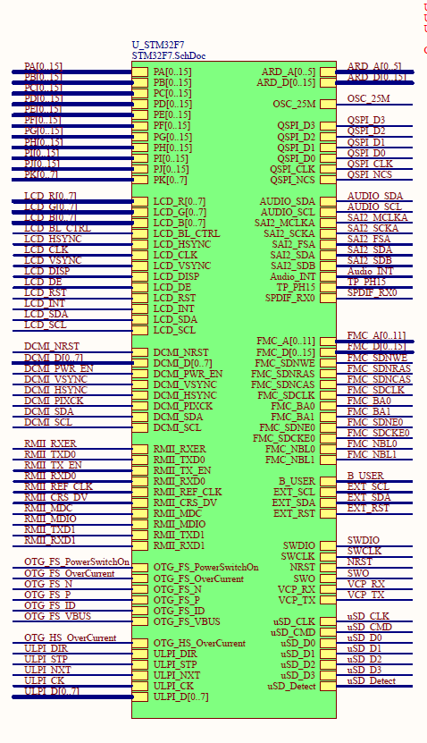
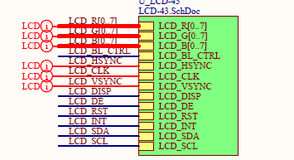

Slide 7
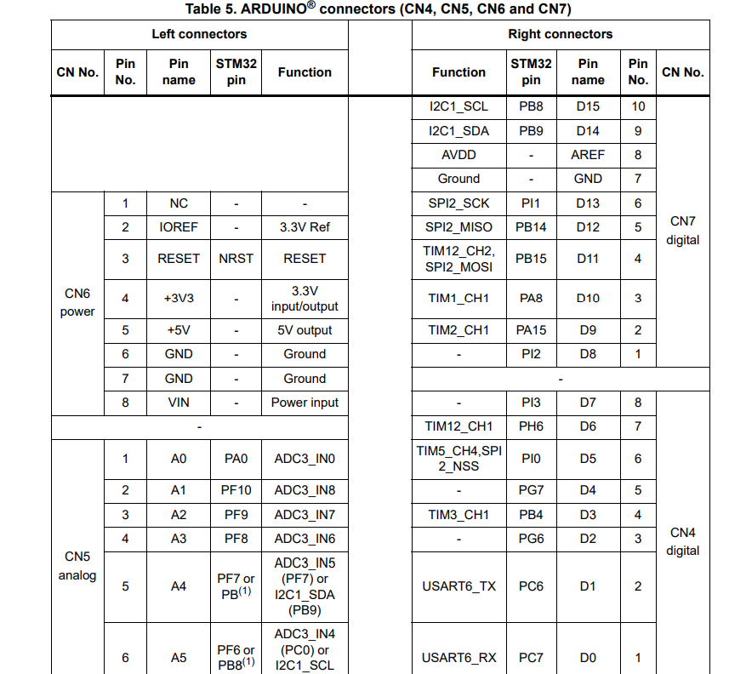
Connectors

Slide 8
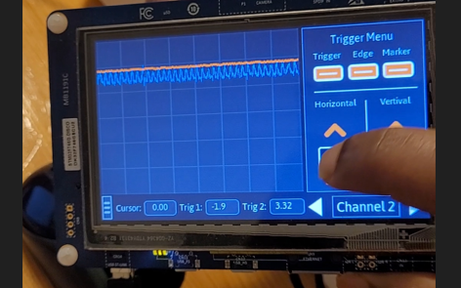
OUTPUT

Slide 9
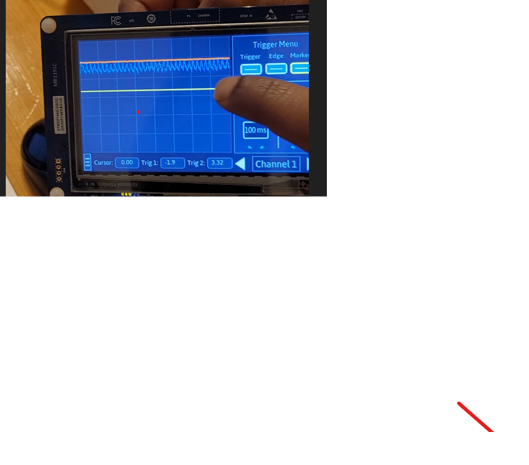

Slide 10
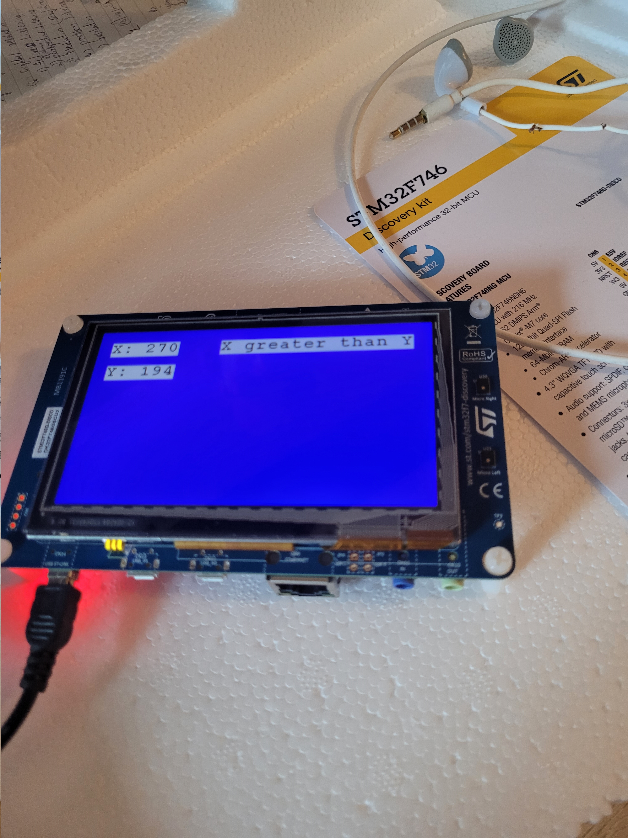

Slide 11
